Slide 1
Lecture 6: gender and the division of labor part 1
SC22o5: Sociology of the family

Slide 2
Announcement
Students who missed the library sessions last week are encouraged to join the library sessions this week
E1 | 15 September | 2.30pm – 3.30pm | Central Library Training Room
E2 | 18 September | 12.30pm – 1.30pm | Central Library Training Room
E3 | 16 September | 2.30pm – 3.30pm | Central Library Training Room

Slide 3
Announcement
Your research paper outline is due today
A soft copy should be submitted to IVLE and a hard copy to your tutor’s mailbox by 5pm

Slide 4
Where we have been…
Introduction to sociology of the family
Family as a social construct
Normal family ideology
Conceptual frameworks in the analysis of the family

Slide 5
Where we are going…
Family Formation, Transitions, and Dissolution
Romantic love and courtship
Marriage and cohabitation
Gender and the division of labor (Today)
Parenthood
Divorce

Slide 6
In this lecture…
Gender and the Division of Labor Part 1
Sex and Gender
Doing Gender
Gender and Power in Families

Slide 7
Sex and gender

Slide 8
Sex and gender
sex
Gender
A person’s biological maleness or femaleness
Chromosomes, sex glands, hormones, internal sex organs, external genitalia, reproductive capacities, and germ cells produced
The psychological, cultural, and social aspects of maleness and femaleness
The characteristics of masculinity and femininity
Notes:
Sex is ascribed to us at birth, while gender is enforced through broader cultural experiences.

Slide 9
The sexual dichotomy
Sexual dichotomy
The division of sex into two and only two categories: male and female
Assumptions
Permanent and universal
Exhaustive
Mutually exclusive

Slide 10
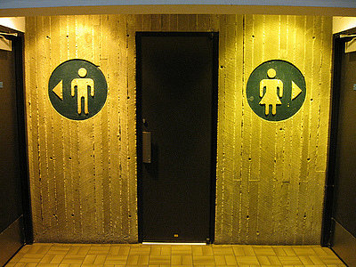

The sexual dichotomy

Slide 11
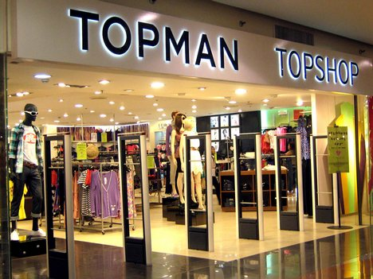
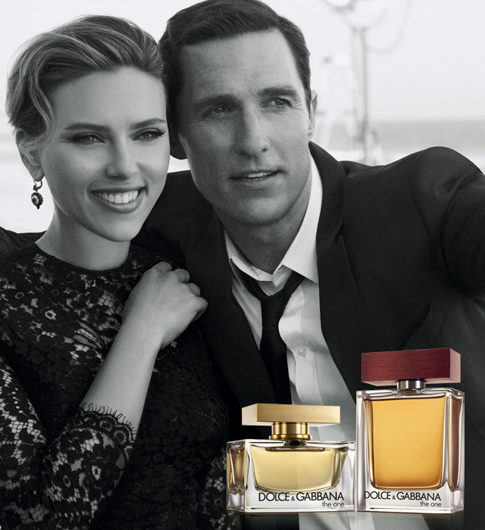
The sexual dichotomy
Notes:
Separate brands, separate living quarters.

Slide 12
Intersexuality
Intersexuals
Individuals in whom biological sexual differentiation is either incomplete or ambiguous
They may have the chromosomal pattern of a female but the external genitals of a male or they may have both ovaries and testicles
About 1% of all babies born have some form of intersexuality
Medical responses to intersexuals supports the historical and cultural belief that there are only two sexes
Notes:
Doctors believe that operation is best for the child to be younger, so that the child has better development.
Individual who has no surgery thought of thinking as excluded in society.

Slide 13
Intersexuality
Medical responses to intersexuals supports the historical and cultural belief that there are only two sexes
Intersexuality is usually defined by doctors as a defective combination of the two existing categories and not as a third category unto itself
Furthermore, a decision is usually made to define the individual as either male or female
In societies with advanced medical technology, chemical and surgical means may be used to establish consistency between anatomy and the social label

Slide 14
Intersexuality
Drastic surgical intervention is undertaken not because the infant’s life is threatened
But because our entire social structure is organized around having only two sexes
The male-female dichotomy is essential to our expectations about family
Those who challenge it are often considered a threat to the basic organizing principle of intimacy and social life

Slide 15
Biological influences on gender
Some researchers have examined differences in the behaviors of male and female babies to uncover the biological underpinnings of gender
Sex differences in the achievement of fundamental development milestones appear within the first year of life
Early enough to make cultural or environmental influence unlikely
Other researchers have argued that even at an early age a wide variety of factors other than biology can affect physical development
For example, in African cultures where mothers actively teach their babies to crawl, they reach this milestone significantly earlier
Notes:
For intersex people, there is no consistency between biology and gender.
Need to take into account what encouragement do parents give to their children.

Slide 16
Cultural flexibility of gender
What it means to be masculine or feminine can vary from place to place
Arapesh
Cooperation, passivity, sensitivity to others
Mundugumor
Assertiveness, emotional inexpressiveness, insensitivity to others
Tchambuli
Women: dominant, shrewd, assertive, managerial
Men: submissive, emotional, delicate
Margaret Mead (1963) Sex and Temperament in Three Primitive Societies

Slide 17
Cultural flexibility of gender
Gender expectations are strongly shaped by social context
For example, when women are rewarded for behaving aggressively, they can be just as violent as men
Conversely, when men are primary caretakers of their children, they can be as nurturing, sensitive, and physically affectionate as mothers
Thinking of sex and gender as the same thing leads us to overlook extensive similarities between the sexes and wide variations within each sex
For example, men as a group do tend to be more aggressive than women
Yet some women are much more aggressive than the average man
And some men are much less aggressive than the average woman
Notes:
Definition of masculinity is not universal, and gender expectations are strongly shaped by the social context.

Slide 18
Doing gender

Slide 19
Doing gender
Children acquire knowledge about gender through socialization
But what they learn are the gender rules that allow them to be perceived as masculine or feminine
To become masculine or feminine, we must “do gender” appropriately and continuously through everyday social interactions
We do gender by behaving in ways that are considered appropriate for our gender
Gender is an accomplishment rather than a fixed attribute of each individual (West and Zimmerman 1987)
Is it possible not to do gender?
Notes:
We do not know how to interact with people if we do not know their gender.

Slide 20
Rewards and costs: Individual level
We may do gender to experience the rewards and privileges that come from acting in ways consistent with individuals’ gender expectations
For example, by acting incompetent at housework, a man may be able to get his wife or sister to cook and clean for him
Women who wear makeup at work are more likely to be seen as attractive, competent and healthy than women who do not
The way we do gender may help us avoid hostile reactions
For example, doing gender can be difficult for men in predominantly female occupations
An individual may lack the personal or social resources to do gender appropriately
For example, unemployed men, especially those who see breadwinning as integral to their masculinity
Notes:
Male nurses are not used to by the society, but still display masculinity by doing certain tasks such as carrying patients.

Slide 21
Rewards and costs: cultural level
The social costs of violating gender norms are not felt evenly by boys and girls or by men and women
For example, the different connotations and implications of the words tomboy and sissy
Structural gender inequalities exist in society
In a society built around and for the interests of men, stereotypically masculine traits are likely to be valued culturally and interpersonally
Consequently, many women conclude that their own success requires such traits
By doing gender in culturally appropriate ways, we submit to the view that gendered social arrangements are natural and normal
Notes:
Boys who are sissy are questioned of their sexuality and wondered if will become homo
Tomboy- less negative
Due to the society that is build around men, and thus

Slide 22
Gender and power in families

Slide 23
power
Gender is not simply a system of classification
Gender also expresses the universal inequality between men and women
When we speak about gender, we speak not only about difference, but about hierarchy, power, and inequality
Power
The ability to impose one’s will on others
Orchestration power
The ability to decide what course of action will be taken
Implementation power
The ability to decide who a course of action will be accomplished
Not who makes the most decisions but who gets to decide which decisions will be made
Notes:
Gender is deeply embedded in our society.

Slide 24
Gender and power in families
Power imbalances are the rule rather than the exception in intimate and family relationships and it is men, not women, who possess power
Researchers interviewed 61 married couples who had faced important family and work choices to determine what factors influenced their decisions
Most of the decisions revolved around the adjustments the wife should make to the number of hours she spent at work
The decision factors were those that traditionally affect women
But when the decisions concerned the husband's job, the couples tended to focus only on whether he ought to switch jobs and not whether he should increase or decrease the amount of time he spent at work
Such “invisible” power is important because it can maintain inequality even in those marriages that appear amicable

Slide 25
Gender and power in families
Other researchers observe that women exercise their power within families covertly
In Japan, women have historically occupied a visibly subservient position both in society and in families
65% of Japanese women work outside the home but they earn about 65% of what Japanese men earn
Women in Japan are significantly less likely to hold supervisory or managerial positions in the workplace
Within Japanese families, women are still expected to clean, cook, and tend to the needs of their husbands
However, women exercise a surprising degree of authority
Many wives control the household finance, giving their husbands monthly allowances as they see fit (control credit cards purchases)
Although men’s public authority made them appear dominant, women actually controlled tremendous informal power in the family

Slide 26
Resources and dependence
Dependence
The degree to which one individual in a relationship relies on the other for important resources
Each individual brings a variety of resources to her or his intimate relationship
We exchange the resources we have for a desired benefit from our partner
Control over a resource creates power differences when we highly value the resource and perceive it as essential
Moreover, it must be something that we cannot obtain elsewhere

Slide 27
Resources and dependence
Power and dependence are inversely related
Because men and women control different types of resources, dependence and power in families are entwined with gender
Men’s greater access to prestigious occupations and higher earnings have historically given them more power and privilege inside their families
However, women are able to claim significant power in families because of their role as kin-keepers
Women may provide emotional support even though they are economically dependent

Slide 28
Resources and dependence
As women have entered the workforce in greater numbers, they have begun to acquire the economic resources that enable them to participate more forcefully in family decision making
The meaning couples attach to these resources
A wife whose husband sees her employment as a threat to him rather than a contribution to the household will derive less power from her wage earning
Conversely, a homemaker married to a man who values her domestic work may actually derive more power from that role

Slide 29
Role of cultural ideology
Cultural ideology may overshadow the effect of monetary resources on family power
In our culture, certain family members gain power from laws, cultural traditions, and social norms
Men control most of the important social institutions
By virtue of their higher social status, they can claim they have legitimate right to exercise power over their wives and children
Women’s economic wellbeing may also be offset by cultural ideologies that value them primarily for the noneconomic resources that they provide
For example, in Korea, researchers have found that wives who work outside the home actually lose power in their marriages (due to the lack of nurturing resources)

Slide 30
Cultural devaluation of women
Power differences ➔ social worth
Girls’ and women’s devaluation in the family and wider society
Access to education is a problem in Afghanistan where groups that oppose female education attack many schools
40 percent of young women in South Asia and Sub-Saharan Africa are married by their 18th birthday
In Pakistan, women are expected to accept arrange marriages and refusal can lead to honor killings that typically go uncontested by the government
India’s recent ruling that rape laws do not apply to married couples illustrates the sexual subjugation and violence that women remain exposed to
In North Sudan, Tanzania, and Lesotho, land ownership and control goes to the male head of the household
Women in the United States earn only 77 percent of what men earn for the same amount of work
Women are still forbidden to drive in Saudi Arabia and must rely on their fathers or husbands to get from place to place
In Bahrain and Egypt, husbands have the right to stop their wives from leaving the country

Slide 31
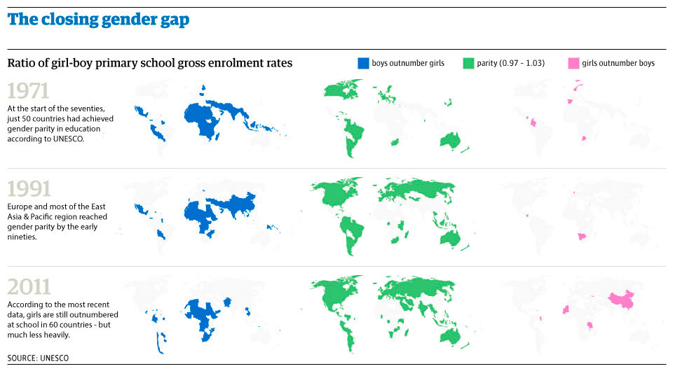
but the news is not all bad…

Slide 32
Summary
Sex refers to an individual’s biological maleness and femaleness while gender refers to cultural and social aspects of maleness and femaleness
Biological and cross-cultural evidence suggest that the two sex categories are neither exhaustive or mutually exclusive
Reliance on biology to explain gender differences overlooks the wide historical and cultural variation in conceptions of masculinity and femininity
Gender is acquired through socialization and reinforced continuously through everyday social interaction
Gender differences are often translated into differences in power and dependence within families
Gender inequality takes a significant economic, psychological, and physical toll on women worldwide

